Slide 1
Math Syntax and R Projects
CSCI 444

Slide 2
Executing R Scripts
File > New File > RScript
  Opens editor
Ctrl-Enter → Runs script
  Cursor
  Highlighted Code Chunk
Although these symbols are used on several lines, R considers it as just one line
%>% → Piping Function
%<>% → Assignment Pipe
+ → Layering Plotting Feature
More to come on these…

Slide 3
Datatypes
 | Converts to Data Type | Tests Data Type
Integer | as.integer() | is.integer()
Double/Numeric | as.numeric() | is.numeric()
Character | as.character() | is.character()
Factor Categorical data | as.factor() | is.factor()
Logical | as.logical() | is.logical()
Date | as.Date() | is.Date()

Slide 4
Operators
<- Assignment
+ - * / ^ Standard operators
  includes exponentiation
Logical
  == EQUAL
  != NOT EQUAL
  < <= > >= RELATIONAL
is.na(x) TRUE if x is NA
  R uses NA not NULL
  is.na(c(2, 7, NA, 3, NA)
  [1] FALSE FALSE TRUE FALSE TRUE
!is.na(x) TRUE if x is not NA
na.omit() → removes NA observations
%in% SELECT if a value is in a vector
  c(1:5) %in% c(3:8)
  [1] FALSE FALSE TRUE TRUE TRUE
%nin% SELECT if a value NOT in vector (sjmisc package)

Slide 5

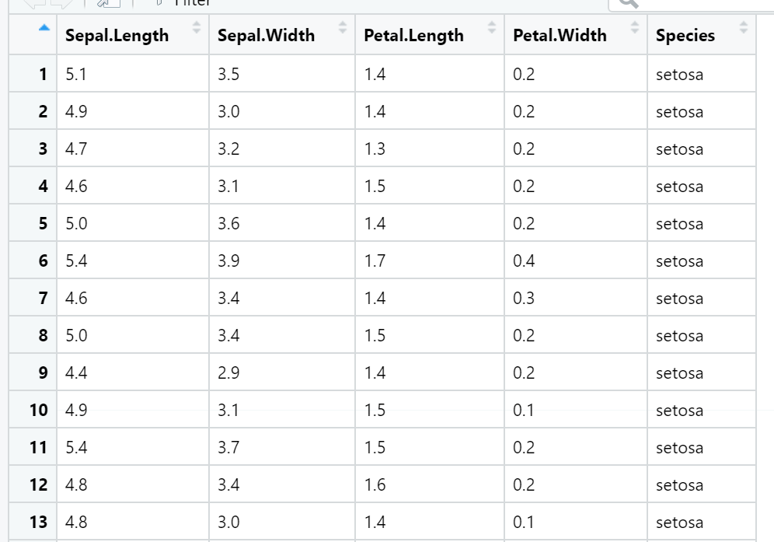
Data Frames
iris data frame
Fisher’s iris data set
Standard rectangular data store
  Analogous to spreadsheets
Columns → Variables
Rows → Observations
Cells → Observational Units

Slide 6
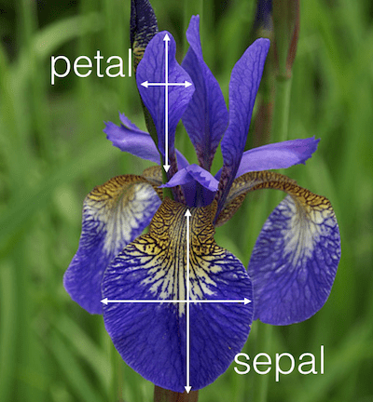
Data Frames
class(dataset) → lists the type of R object
  class(iris) → [1] “data.frame“
View(dataset) → lists all observations in its own window
head(dataset) → lists first 6 observations in Console
name(dataset) → lists all variables in Console
Subsets
  petalInfo <- iris[ , 3:4] Adjacent Variables (Slice)
  lengthInfo <- iris[ , c(1, 3)] Non-Adjacent Variables
Reference Specific Variable
  Use $ to EITHER reference a variable OR create a new one
  iris$Petal.Length ALREADY existing variable
  iris$Total.Length <- iris$Petal.Length + iris$Sepal.Length NEW variable

Slide 7
R Functions
R functions assign arguments in order
  Name arguments when out of order
  Defaults used when argument not assigned
diff(x, ...)
Arguments
x a numeric vector containing the
values to be differenced.
lag an integer indicating which lag to use.
differences an integer indicating the order
of the difference. Number of
times diff is called.
... further arguments to be passed to or
from methods.
data <- c(1, 3, 5, 7, 11, 13, 17)
z <- diff(data, 2)
Which variable in the list of arguments is assigned 2?
What is the value of the other variable?
data <- c(1, 3, 5, 7, 11, 13, 17)
x <- diff(data)
x [2 2 2 4 2 4]
y <- diff(data, differences = 2)
y [0 0 2 -2 2]
First → (1-3), (5-3), (7-5), (11-7), (13-7), (17-13)
Second → (2-2), (2-2), (4-2), (2-4), (4-2)

Slide 8
Lab 1
In ggplot, why could we code without designating mapping?
  ggplot(aes(x=x, y=y…))
v.
  ggplot(mapping = aes(x=x, y=y…))
?ggplot
datasaurus_dozen %>%
ggplot(aes(x, y, color = dataset))+
geom_point()+
facet_wrap(~ dataset, ncol = 3)

Slide 9


R Projects
Easier to import
Improve reproducibility
Improve collaboration
Working Directory
  R looks here for data files
  Projects by definition are the working directory

Slide 10
R Projects
Modify Global Options to prevent issues with R Projects
Tools > Global Options deselect
    RSessions → Restore most recently opened projects at startup
    RSessions → Restore previously open source documents at startup
    Workspace → Restore .RData into workspace at startup
    History → Always save history
Create a project
  File > New Project > Empty Project
  Create separate folders for data & images

